Slide 1
Lecture 1.2 AI Introduction
Edge AI and Robotics Teaching Kit

Slide 2

The Edge AI and Robotics Teaching Kit is licensed by NVIDIA and UMBC under the
Creative Commons Attribution-NonCommercial 4.0 International License.

Slide 3
Topics
Introduction
What is AI
History of AI
NVIDIA Jetson Developer Kits
Deep Learning

Slide 4
About this course
Provides a comprehensive overview of Artificial Intelligence; its use cases; and how it fits into the Data Science and Big Data ecosystem. We will cover the core concepts of computational modeling that make up intelligent agents and machines with a focus on Embedded and Edge computing and then apply those concepts to real world scenarios to teach machines to act in accordance with those models and agents.
Some labs may be completed using your laptop and Python and any with GPU accelerated code will be implemented on the Jetson Nano 2GB.
There will be in module quizzes and class labs. A final project using Jetson Nano is recommended.

Slide 5
Learning Objectives
Define artificial intelligence (AI)
List examples of applications of AI
Describe the different types of hardware implementations for AI computing
Describe the difference between CPU and GPU processing
Write and execute code and compare differences between CPU and GPUs

Slide 6
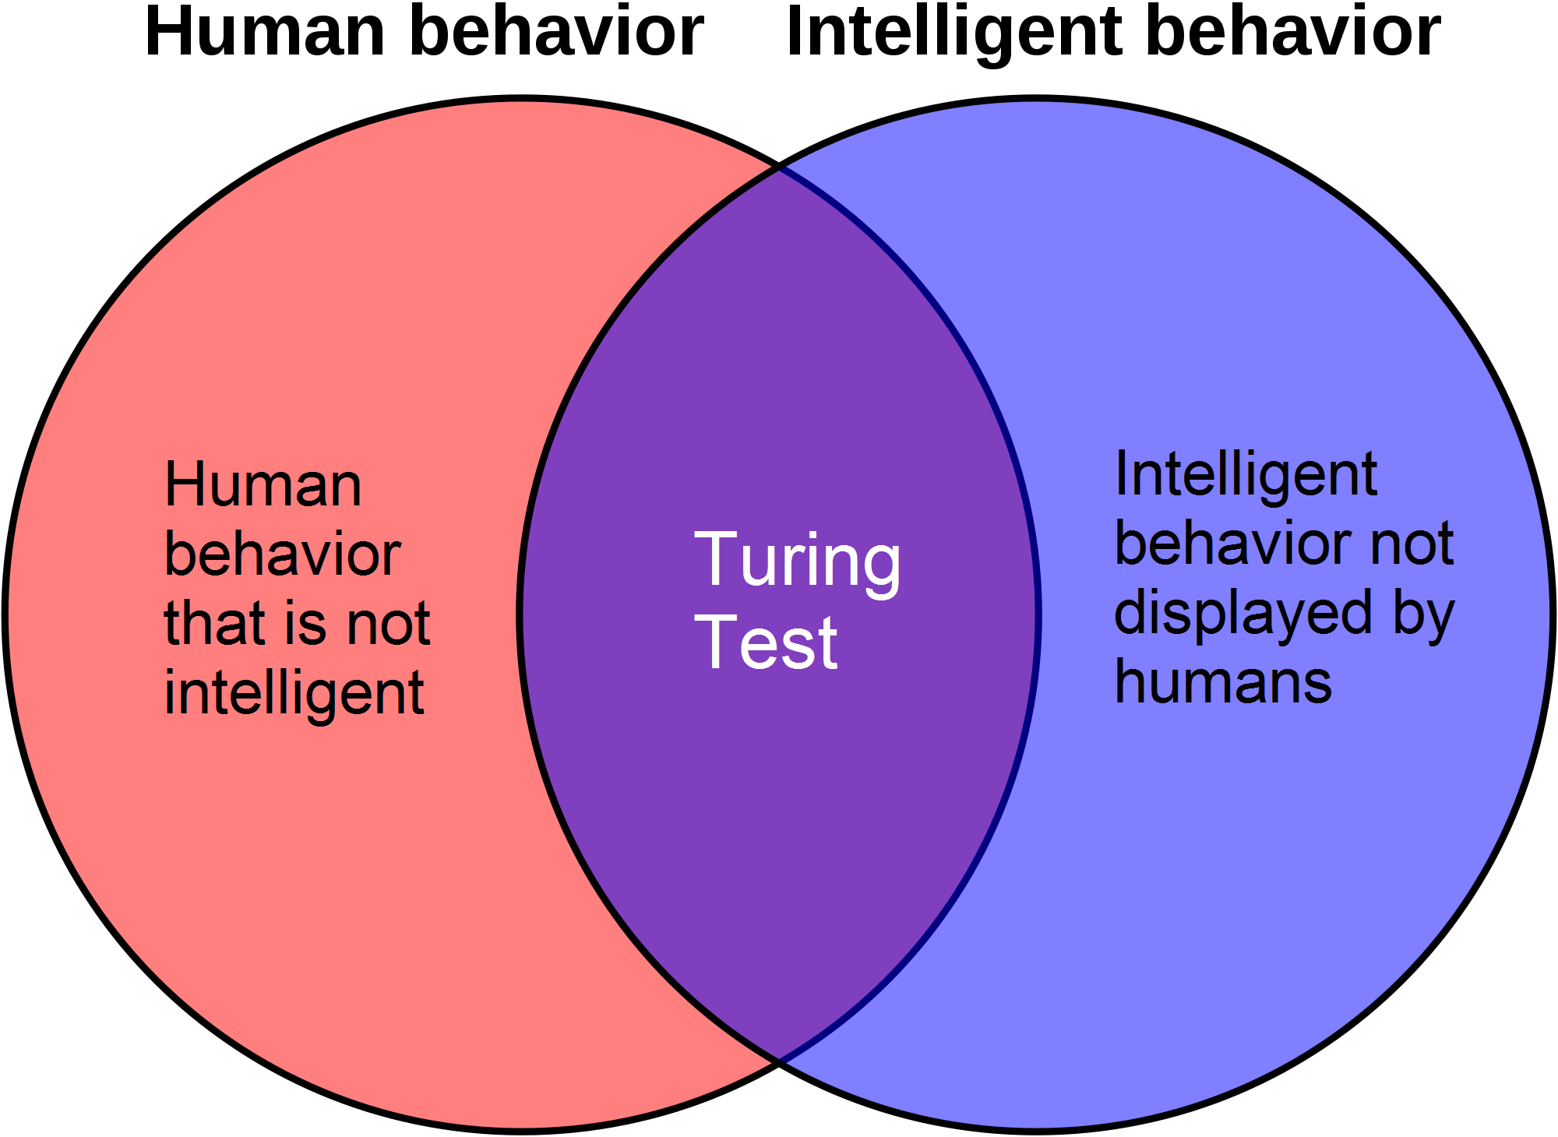
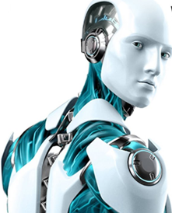
Artificial Intelligence (AI)
What is AI?
This Photo by Unknown Author is licensed under CC BY-SA-NC
Artificial Intelligence is the emulation of human or biological behavior
Real intelligence that is generated artificially
Derived from study of computational agents that act intelligently (http://artint.info/2e/html/ArtInt2e.Ch1.S1.html )

Slide 7
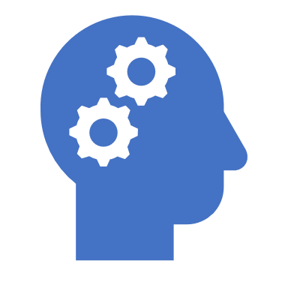
Evolution of AI

Slide 8
History of AI
Hobbes (1588-1679) – thinking was symbolic reasoning like talking out loud or working out an answer with pencil and paper
1950 Alan Turing –Asked, ‘ Can machines think?
1990s First Websearch engines
IBM’s Deepblue beat Garry Kasparov at Chess
2020 Smart homes
Self Driving Cars
1959 AI lab founded at MIT
Birth of AI
AI Winter
Computing enhancements
Lots of data
Algorithm enhancements
1956 AI coined by John McCarthy Dartmouth College
1989 NASAs Autoclass program – identifies new stars
2010 GPUs/Big Data /Deep Learning
NLP
Computer Vision
https://aitopics.org/misc/brief-history
http://artint.info/2e/html/ArtInt2e.Ch1.S2.html
Notes:
With the history of AI, one can think of it as a journey from a set based of programmatic rules and instructions into a more sophisticated ecosystem of data, deep learning and prescriptive analytics. By prescriptive, you see devices recommending a course of action based on the results of inference data into predictive models.

Slide 9
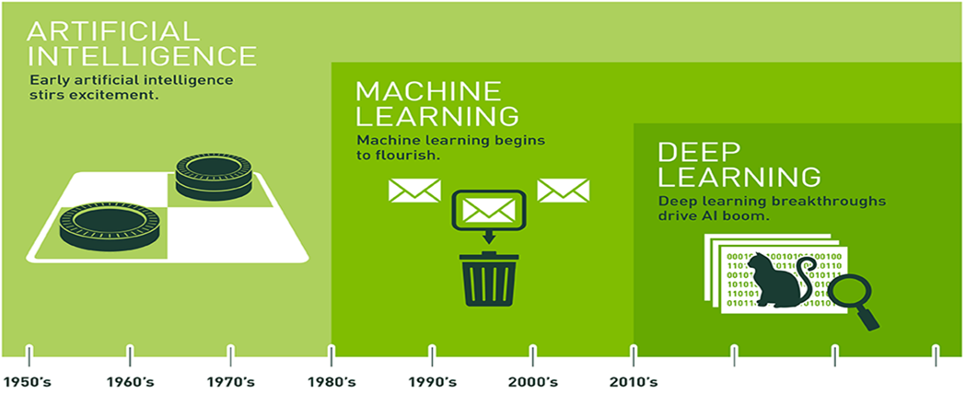
Evolution of AI
Notes:
This is another look at the evolution of AI. In the 80s through early 2000s, there was quite a bit of maturity with statistical software tools the provided ways to build analytic models. These tools were mostly desktop based and where limited to those compute resources. It was not uncommon for complex analysis on larger datasets to take days or even weeks to process. This past decade has observed significant breakthroughs that is helped to drive the AI Boom. The perfect storm of Big Data, GPUs and optimized Neural Networks are critical components that enabled significant innovation in AI.

Slide 10
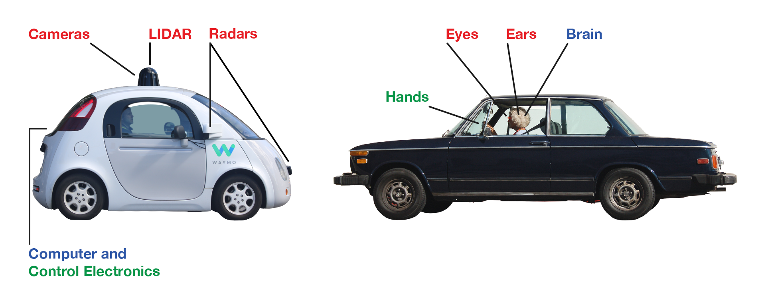
Applied AI
This Photo by Unknown Author is licensed under CC BY-SA-NC
Put AI into practice for real world applications
Notes:
How can we put AI into practice? Today you can see applications of AI all around you. Many of the new cars now have electronics that can help park your car or alert you to obstacles in your blind spot. The US Postal Service has implemented AI to identify potentially hazardous materials. Much of that technology is run on NVIDIA GPUs.

Slide 11
Real World Applications of AI
Self Driving Cars
Facial Recognition for Identification
Deposit Checks through Mobile Apps
Robotic Floor Cleaners
Network Intrusion
Loan risk models
Recommendation engines for shopping product and movie recommendations
Email spam detection
Notes:
Other applications of AI include facial recognition for identification. I have many applications on my phone that only can be unlocked using my face for identification. Robotic floor cleans like Roomba are common in many households. There are even autonomous lawn mowers. Federal agencies are looking into ways to add analytics to Network Intrusion systems to provide a quicker response time to possible network risks or attacks. Many financial institutions use credit card and loan applications with capabilities to automatically approve or deny a loan. Shopping web sites like Amazon use AI powered recommendation engines to advertise products of interest.

Slide 12
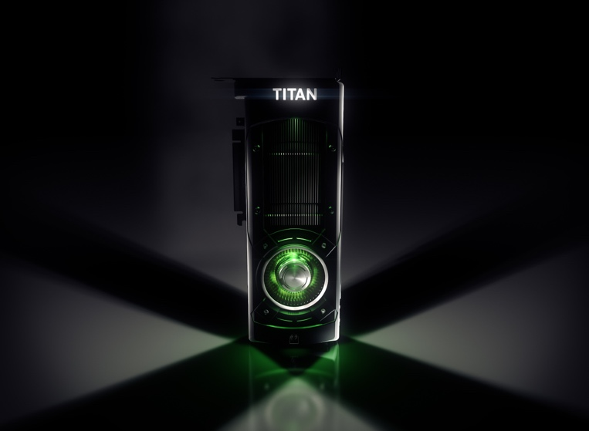
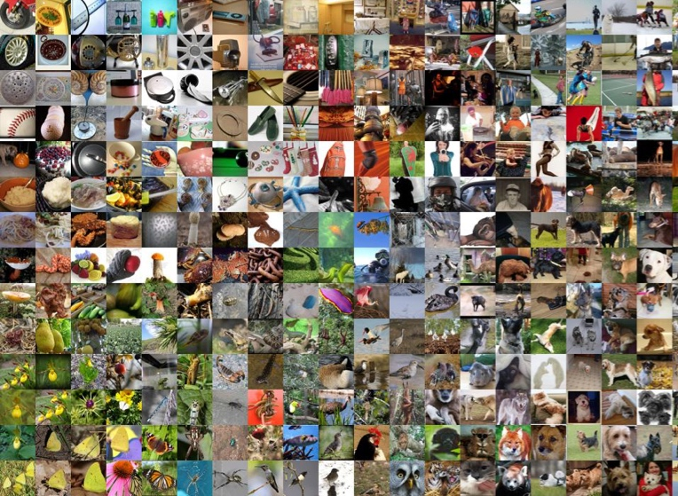

THE BIG BANG IN MACHINE LEARNING
DNN
GPU
BIG DATA
Notes:
This slide is at the core of the rapid emergence of AI. What is it that caused this revolution in Machine Learning? Three things happened at nearly the same time that enabled revolutionary advances in Machine Learning.
First, improvements in the solvers of Deep Neural Networks (DNN) and techniques such as the Convolutional Neural Network (CNN) made their use more tractable.
Significant advancements with DNNs started with AlexNet architecture in 2012
Second, the big data movement has provided the data necessary to train deep networks.
2.5 quintillion bytes of data produced each day
With the introduction of social media there has been a proliferation of data – primarily images and text
Third, the GPU has provided the computational power necessary to solve DNNs in reasonable amounts of time
GPUs allow Data Scientist to build better models faster. Data Scientist can run more trial and errors using GPUs than with CPUs
Models can make decisions faster using GPUs
GPUs can be 2X to 10X faster than CPUs
The computing power needed by Deep Learning to train large amounts of data is a key factor for why companies need GPUs.

Slide 13
Framework and Hardware for Class
Much of what we will do in this course involves using Deep Learning to process images and text.
Deep Learning is computationally intensive and benefits from using GPUs to run some of those operations in parallel, especially for Image and Natural Language processing.
Rather than require expensive GPU laptops, we will use the Jetson Nano
We will use Python to code applications that use CUDA enabled libraries and deep learning framework

Slide 14
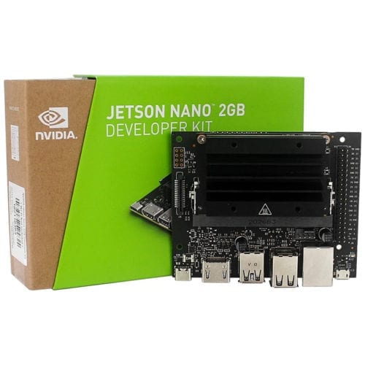
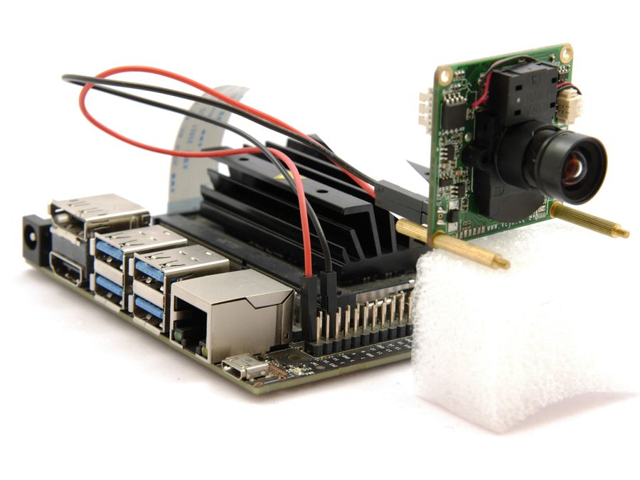
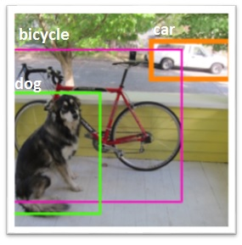
GPUs
Why Jetson Nanos
advanced GPU computing for AI
cost effective
small form factor
extensible
This Photo by Unknown Author is licensed under CC BY
This Photo by Unknown Author is licensed under CC BY
This Photo by Unknown Author is licensed under CC BY

Slide 15
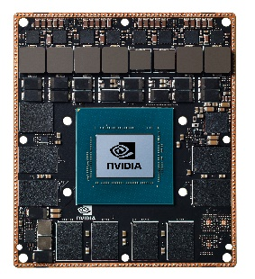
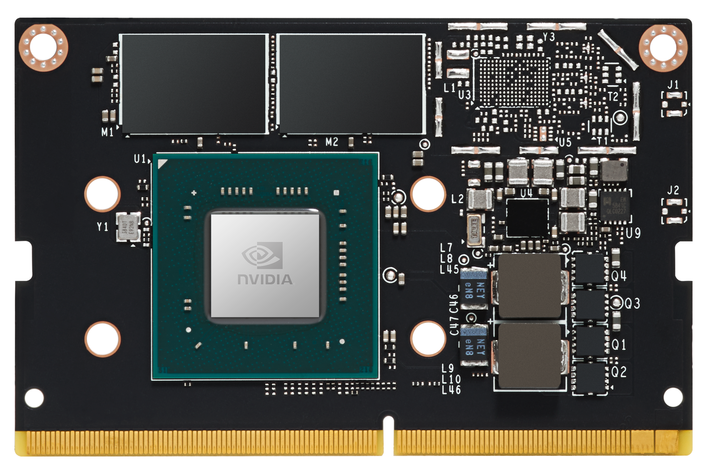
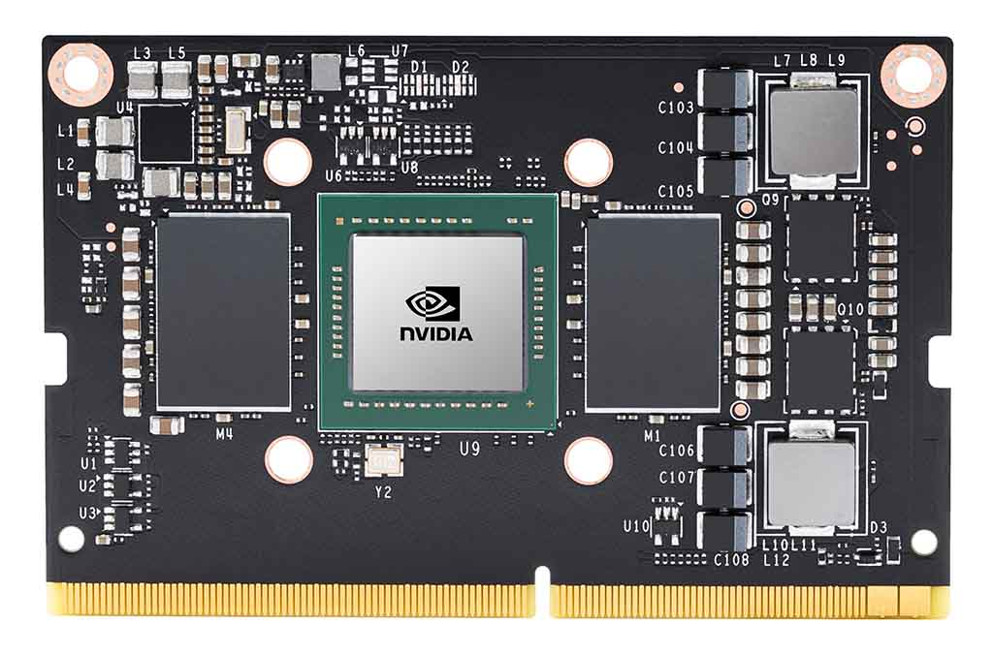
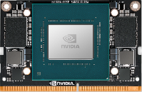
THE JETSON FAMILY
for AI at the Edge and Autonomous System designs
JETSON NANO
0.5 TFLOPS (FP16)
JETSON TX2 NX
1.3 TFLOPS (FP16)
JETSON XAVIER NX
6 TFLOPS (FP16)
21 TOPS (INT8)
JETSON AGX XAVIER series
11 TFLOPS (FP16)
32 TOPS (INT8)
5 - 10W
45mm x 70mm
7.5 – 15W
45mm x 70mm
10 - 15W
45mm x 70mm
10 – 30W
100mm x 87mm
AI at the edge
Fully autonomous machines
Multiple modules - Same software
Full specs at developer.nvidia.com/jetson

Slide 16
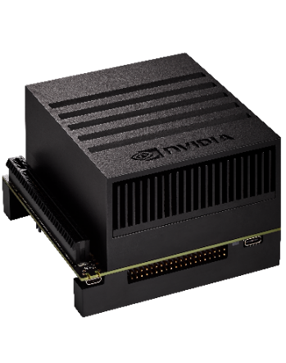
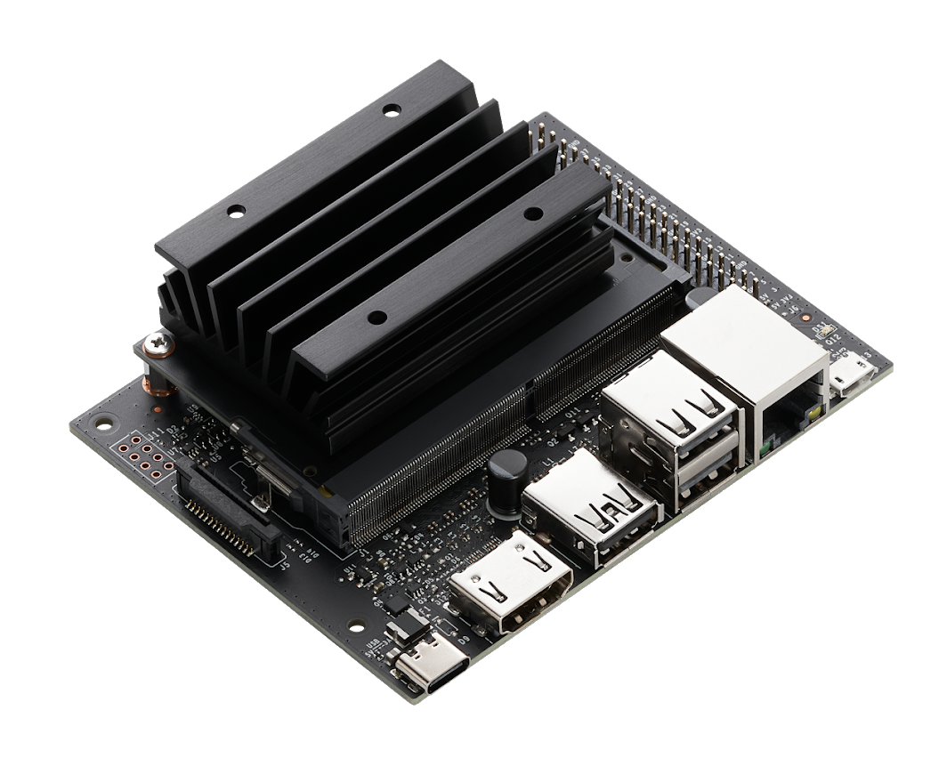
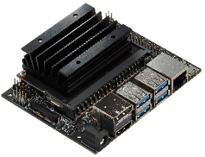
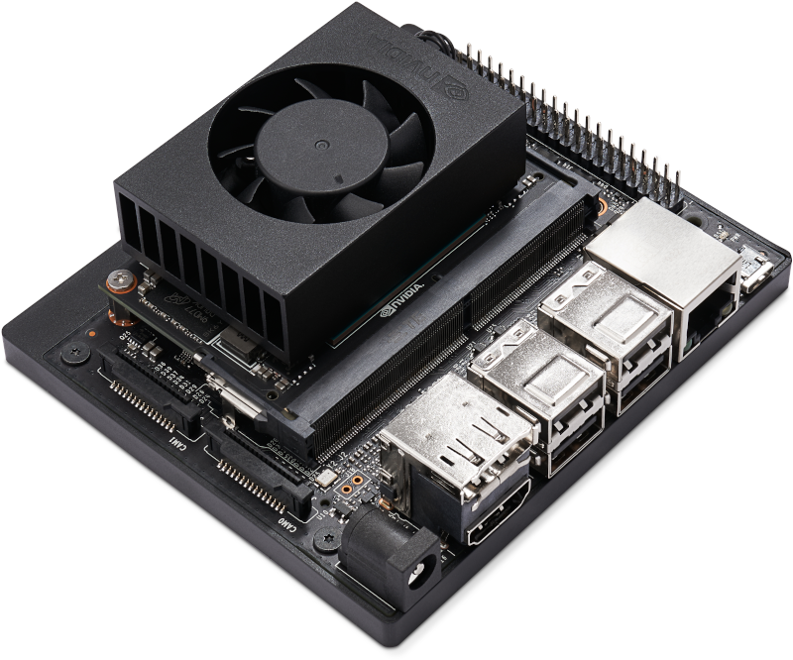
JETSON DEVELOPER KITS
for Engineers, Makers, and Learners
JETSON NANO 2GB
JETSON NANO
JETSON XAVIER NX
JETSON AGX XAVIER
5W | 10W
0.5 TFLOPS (FP16)
$59
5W | 10W
0.5 TFLOPS (FP16)
$99
10W | 15W
6 TFLOPS (FP16) | 21 TOPS (INT8)
$399
10 | 15W | 30W
11 TFLOPS (FP16) | 32 TOPS (INT8)
$699
Multiple developer kits - Same software
Full specs at developer.nvidia.com/jetson

Slide 17

GPU Programming Languages
Numerical analytics
MATLAB, Mathematica, LabVIEW
Fortran
CUDA Fortran
C
CUDA C
C++
CUDA C++
Python
PyCUDA, OpenCV CUDA, Numba, NumbaPro, RAPIDS
F#
Alea.cuBase
© NVIDIA 2013
Notes:
There are a variety of available GPU programming languages and interfaces. The languages include C, C++, C#, Fortran, Python, and numerical analytics packages such as MATLAB, Mathematica, and LabVIEW.

Slide 18
NVIDIA CUDA
Development environment and ecosystem to enable GPU applications
Integrates with programming languages, GPU libraries and deep learning frameworks
https://developer.nvidia.com/cuda-toolkit

Slide 19
Deep Learning Concepts
Deep Learning – Machine Learning that leverages Neural Networks with many layers
Reinforcement Learning – reward-based algorithm with the intent that actions will result in greater cumulative reward https://en.wikipedia.org/wiki/Reinforcement_learning
Federated Learning – machine learning technique enables the training of models across devices without exchanging the data https://en.wikipedia.org/wiki/Federated_learning

Slide 20
Deep Learning – Neural Networks
AlexNet https://en.wikipedia.org/wiki/AlexNet – Deep Convolutional Neural Network
Resnet https://en.wikipedia.org/wiki/Residual_neural_network – Residual Neural Network
Numerous types of Neural Networks. Helpful info on neural network architecture can be found at https://www.asimovinstitute.org/author/fjodorvanveen/

Slide 21
Popular GPU Frameworks
CAFFE https://caffe.berkeleyvision.org/
MXNet https://mxnet.apache.org/versions/1.7.0/
Tensorflow https://www.tensorflow.org/
PYTORCH https://pytorch.org/

Slide 22
Python – GPU Enabled Libraries
Tensorflow GPU https://www.tensorflow.org/install/gpu
Numba http://numba.pydata.org/ highly performance optimized C code that can be run from within Python that is designed to work with Numpy arrays and functions.
PyCuda https://pypi.org/project/pycuda/
RAPIDS https://rapids.ai/ - new GPU data science library that is modeled to provide similar look and feel of Panda and Scikit Learn libraries. It is currently not supported on the Nano
OpenCV CUDA https://opencv.org/platforms/cuda/

Slide 23
Edge AI and Robotics Teaching Kit
Thank You

